Slide 1
WORK ACCOUNT FOR THE PERIOD 01.07.2016 to TILL DATE
SURENDRANATH P
Staff No: IS03651
Scientist/Engineer ‘SE’
Section Head
EDP, WEB DEVELOPMENT AND TELECOM MANAGEMENT SECTION (EWTS)
MANAGEMENT INFORMATION SYSTEMS DIVISION (MISD)
PROGRAMME PLANNING AND EVALUATION GROUP (PPEG)
U.R. RAO SATELLITE CENTRE - BENGALURU
Roles | Section Head for EWTS, MISD, PPEG, URSC Team Lead, IPWS Engineer In-charge, Telephones, URSC
Responsibilities | Management Information Systems (MIS) required for management and administrative related activities of URSC. Voice Communication Management of URSC campuses.
Deliverables | Realization of ISRO/DOS PFMS Web Services Interface System (IPWS). Realization of COINS-PFMS Interface Software. Online information for administrative related activities using Sandesh system. e-Governance initiatives in URSC. Moving towards next generation MIS. Continuous voice communication services to URSC campuses.

Slide 2
Specific Achievements
Successfully completed Requirement elicitation, Design, Development, Testing and Implementation of ISRO/DOS PFMS Web Services Interface System (IPWS) and serving its objective satisfactorily in all ISRO/DOS centres.
Successfully operationalized COINS-PFMS Interface Software in all ISRO/DOS centres.
Successfully operationalized Online TA Module, Telephone Bills Reimbursement, Payment details to suppliers through email/SMS, connection pooling concept, etc as enhancements of Sandesh system.
Successfully implemented Git software version control tool.
Demonstrated prototype Integrated MIS with distributed databases using Spring-BOOT technology.
Published a paper on ‘e-Governance Initiative in URSC - Automation of various Government-to-Employee (G2E) Services’ and same has been selected for oral presentation.
Augmenting and Upgradation of Voice Communication Systems at URSC campuses.

Slide 3
Technologies, Tools and Products Used
Description | Technology / Tool / Product
Persistent Tier | Sybase ASE 15.7
Application Tier | J2EE, JQuery, Web Services, Spring BOOT
Presentation Tier | Boot Strap, HTML, CSS
Testing Tools | Acunetix, IBM Security AppScan, Coverity (COTS), SonarQube CE (OSS), Jmeter, Selenium
Tools | rsync - File Transferring, Git - Software Version Control
Requirement / Design | UML, Swimline Diagrams and Posters
Documentation | Doxygen

Slide 4
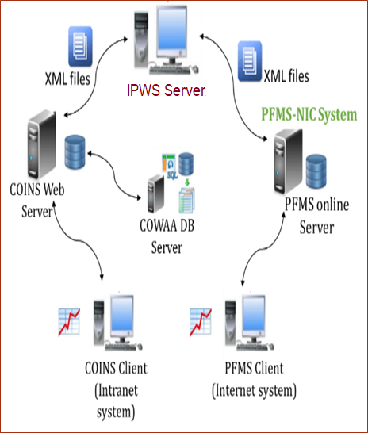
ISRO/DOS PFMS Web Services Interface System (IPWS)
IPWS is background process that processes XML input requests received from COINS and validate it before sending it to PFMS web services consumption system for obtaining desired responses.
Team Lead and responsible for complete SDLC of this system.
Developed scripts for transferring XML files between COINS and IPWS servers using rsync utility.
Ensuring cyber security.
Providing operationalization & maintenance support.
Technologies used – CentOS, Java 1.8, Simple Object Access Protocol (SOAP), log4j-API and Quartz job scheduling library.
Presently IPWS is serving its objective satisfactorily across all ISRO centres/units.
ARCHITECTURE OF COINS-PFMS INTERFACE SOFTWARE

Slide 5
COINS-PFMS Interface Software
An interface to PFMS through web service consumption using XML files - jointly developed by SDSC and URSC.
Contributed from conceptual design to operationalization.
As a member of COINS-PFMS Interface Software Review Committee constituted by Chairman, ISRO, identified & addressed all post operational critical issues and stabilized system for day to day operational activities.
As a member of PFMS Interface Software T&E committee carried out exhaustive verification and validation of COINS-PFMS Interface Software and submitted detailed test results report.
As a team lead carried out Code Walkthrough of COINS-PFMS Interface Software and submitted detailed report.
As a member of Inter Centre Change Control Committee (ICCCC) provided necessary guidance and suggestions for proposed modifications and enhancements.
Input XML Files
Input XML file over Web service
COINS
IPWS
PFMS
Response XML files as success/failure
Web service response in XML format
After implementing this system achieved high financial discipline with transparency and electronically disbursing of payments to payee bank accounts.

Slide 6
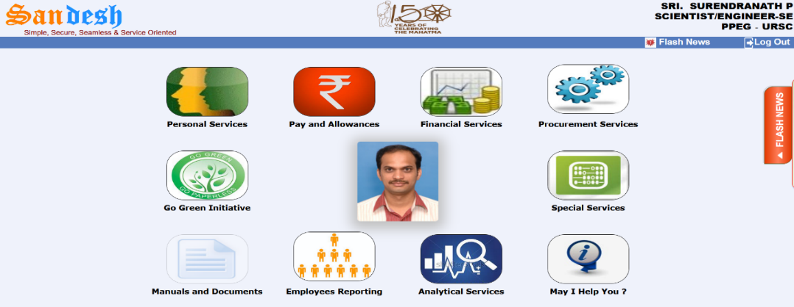
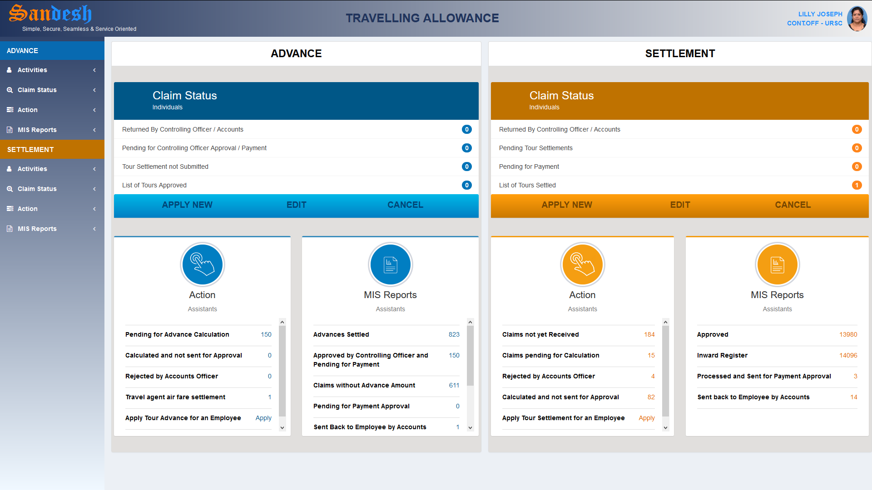
Sandesh - The Information System
Sandesh system provides required personal information to employees, MIS reports to management for decision making based on COWAA database.
Responsible for complete SDLC of this system.
Successfully operationalised online Official Travelling Allowance bills processing, Telephone Bills Reimbursement, Payment details to suppliers through email/SMS, etc as a part of enhancements and providing maintenance support.
Successfully implemented concept of CONNECTION POOLING.
Successfully operationalized email and SMS gateway interface which enables e-Governance.
Sandesh system deployed at VSSC, LPSC(B), HSFC, MCF, ISRO HQ and PRL.
Technologies used – J2EE, Boot Strap and JQuery.
SANDESH HOMEPAGE
After implementing this system reduced queries/calls between administration areas and employees, saved time/paper, provides effective working environment.
TA MODULE DASH BOARD

Slide 7
Additional Activities
As a co-author submitted technical paper on ‘e-Governance Initiative in URSC - Automation of various Government-to-Employee (G2E) Services’ to ISRO Seminar on Computer and Information Technology (ISCIT) – 2018 and same has been selected for oral presentation.
Designed, developed and demonstrated a prototype model to fetch data from distributed databases over the network using latest SPRING-BOOT Technology.
This demonstrates data retrieved from across all ISRO centers and processing at a common server to extract desired outcome which shall help management for decision making.
Implemented software version control system using Git tool for all software developmental activities of MISD/PPEG, URSC.
Responsible for operation and maintenance support for finance, accounts, payroll, purchase and stores related modules of COINS.

Slide 8
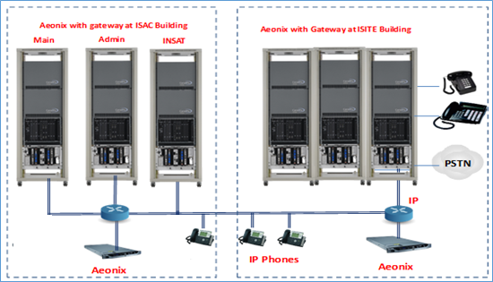
Voice Communication Management of URSC
As an Engineer In-charge, Telephones responsible for planning, augmentation, replacement and maintenance of all telecommunication related activities of the centre.
Realization of upgradation and augmentation in URSC/ISITE EPABX systems.
Ensuring continuous voice communication services through Electronic Private Automatic Branch Exchange (EPABX) systems.
Provided 600 additional telephone connections by reusing of ISTRAC EPABX system components, in effect saved about ₹35 lakhs to organization.
Proposed configuration of upgradation and augmentation in URSC/ISITE EPABX systems

Slide 9
Thank You

